Slide 1
Build a Social Business
Creating a social business that is to say, a business that is connected through deliberately collaborative processes with both its customers and its employees is the task now facing many C-level and other business executives with similar responsibilities.

Slide 2
What Is Social Business?
Social business the application of social technologies as a formal component of business processes revolves around understanding how your customers or stakeholders connect to your business and how you reshape your business to understand, accept, and innovate based on their involvement.
Social business is about integrating all of your business functions like customer support, marketing, the executive team, and more.
It means doing this for the purpose of creating collaborative innovation and engagement at meaningful, measurable levels tied clearly and directly to your company’s business objectives.

Slide 3
Social Businesses Are Participative
Ultimately, social business is about participation with and by your customers and stakeholders in pursuit of an organization that is strongly connected to them through participative and collaborative processes.
As a result, a social business is often better able to respond to marketplace dynamics and competitive opportunities than a traditionally organized and managed firm.
This may occur through participation in a social community, a support or discussion forum, or any of a variety of other social applications and contexts.

Slide 4
Build Around Customer Participation
Regardless of who the community is intended to serve, strong communities are best built around the things that matter deeply to the members of the community: passions, lifestyles, causes, and similar fundamentally aligned needs.
This applies whether the audience is primarily business B2B communities like Element 14’s engineering community or Dell’s “Take Your Path” small business owners community form around very specific shared needs common to small business owners—or a personal-interest B2C or nonprofit or cause related community.

Slide 5
Cont…
The core elements powering a social business in any case need to be something to which the community members (customers or potential customers, for example) will spontaneously bond, and that as a result will encourage them to invite others to join.

Slide 6
Participation Is Driven by Passion
Getting the activity focused on something larger than your brand, product, or service is critical to the successful development of social behavior within the customer or stakeholder base and as well within the firm or organization itself.

Slide 7
In Search of a Higher Calling
The surest way to avoid this trap is to appeal to passion, lifestyle, or cause in other words, to anchor your initiatives in something larger than your brand, product, or service: Appeal to a “higher calling,” in a manner of speaking, one that is carefully selected to both attract the people you want to associate with and to provide a natural home or connection to your brand, product, or service.

Slide 8
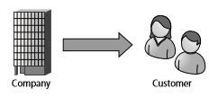
Cont…
You make it, you tell your customers about it, and they (hopefully) buy it. This works well enough provided your product or service delivers as promised with little or no need for further dialog. It helps too if it is marketed in a context where traditional media is useful and covers the majority of your market

Slide 9
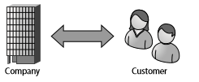
Cont…
As shown an evolved view of business and the beginning of a move away from a purely transactional view of the customer: The customer receives (or consumes) marketing messages, for example, buys the product or service, or enrolls in your organization, but then also goes on to provide feedback, whether directly through a survey card, via CRM or similar or through a listening program that collects and analyzes conversations. The difference is that there is a feedback mechanism.

Slide 10
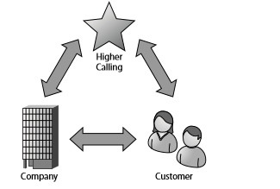
Cont…
Social media takes this practice to the next level. Social media inherently revolves around passions, lifestyles, and causes the higher calling that defines larger social objects to which participants relate. The social media programs that are intended to link customers to communities and shared social activities around the business, and thereby around the brand, product, or service must themselves be anchored in this same larger ideal.

Slide 11
$pend Your Way to a Social Presence

